Slide 1
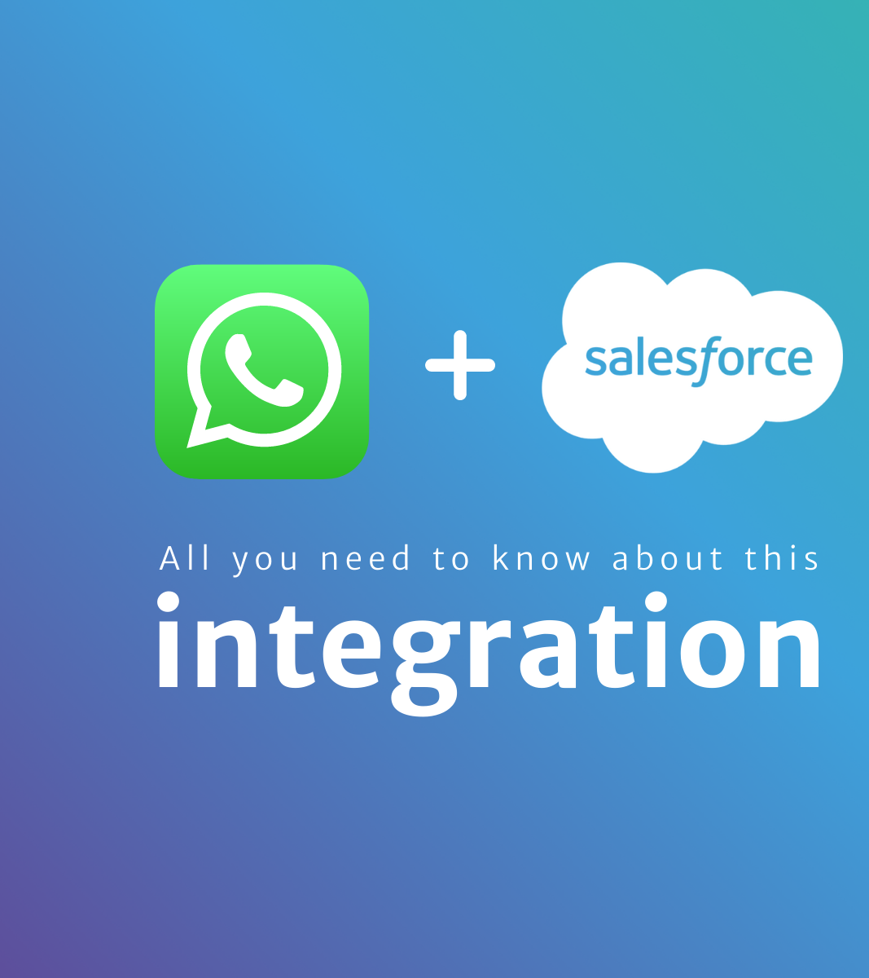


WhatsApp Integration
Presented by
Janaki P

Slide 2
Agenda
Introduction
Benefits of WhatsApp Integration
How it works?
Meta App Development and WhatsApp Setup
Requirements of WhatsApp Integration with BC
Parameters and Messages
AL Code Samples and DEMO
References

Slide 3

Introduction
Integrating WhatsApp with Microsoft Dynamics 365 Business Central can be a powerful solution to enhance communication and streamline business processes. WhatsApp is one of the most popular messaging platforms globally and integrating it with Business Central allows for efficient customer engagement, order tracking, and more.
This integration brings the convenience of real-time communication to your business processes, enabling seamless interaction with customers, suppliers, and employees.

Slide 4
Benefits of WhatsApp Integration
Efficient Customer Engagement
Order Tracking and Notifications
Personalized Marketing
Instant Support
Internal Communication
Efficient Task Management

Slide 5

How It Works?
The integration typically involves using connectors or APIs to link WhatsApp to your Business Central environment. You can set up automated triggers, such as order status changes, and have these events trigger WhatsApp messages to relevant stakeholders. Conversations and interactions can also be logged within Business Central for future reference.

Slide 6

Meta App Development
To send and receive a first message using a test number, complete the following steps:
Set up developer assets and platform access
Send a test message
Configure a Webhook
Receive a test message

Slide 7
Set up Developer Assets and Platform Access
The Cloud API and Business Management API are part of Meta’s Graph API, so you need to set up a Meta developer account and a Meta developer app. To set that up:
1. Register as a Meta Developer
2. Enable two-factor authentication for your account
3. Create a Meta App: Go to developers.facebook.com > My Apps > Create App. Select the Business type and follow the prompts on your screen. If you are asked to choose a Use Case as part of the app creation flow, choose Other as your use case, then select Business.

Slide 8

WhatsApp Setup
From the App Dashboard, click on the app you would like to connect to WhatsApp. Scroll down to find the "WhatsApp" product and click Set up.
Next, you will see the option to select an existing Business Manager (if you have one) or, if you would like, the onboarding process can create one automatically for you (you can customize your business later, if needed).
Make a selection and click Continue.

Slide 9
WhatsApp Setup
1. Associate your app with the Business Manager account that you selected earlier (or had created for you).
2. Generate a WhatsApp Business Account.
3. Generate a test business phone number and associate it with your WhatsApp Business Account. You can use this number with the API to send an unlimited number of messages to up to 5 recipient phone numbers. Recipient phone numbers can be any valid number, but you must verify each one in the next step.
4. Redirect you to the WhatsApp > API Setup panel in the App Dashboard.

Slide 10
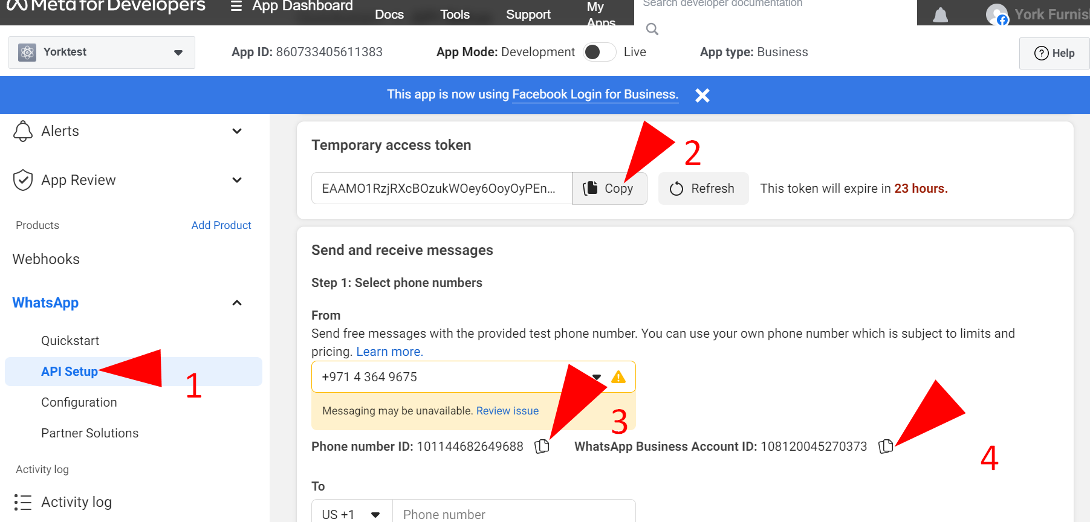
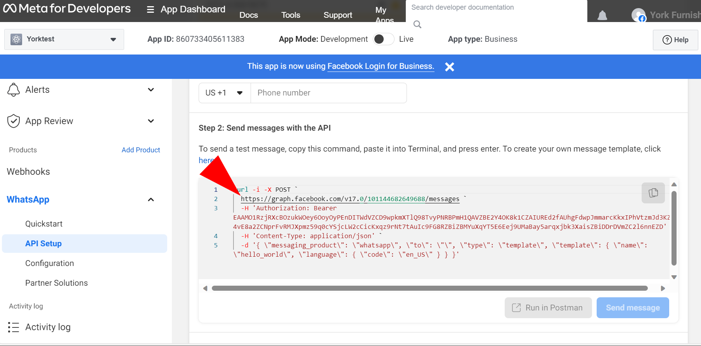
Requirements of WhatsApp Integration with BC
WhatsApp API
Phone Number ID
Bearer Access Token

Slide 11
Parameters and Messages
Parameters
Messages
Text Object
Media Object
Contacts Object
Location Object
Template Object
Components Object
Parameter Object
Button Type
Hsm Object
Interactive Object
Section Object
Audio messages:
Document messages, using filename:
Document messages, using link:
Video messages, using link:
Text messages:
Interactive messages (lists):
Interactive messages (reply buttons):
Interactive messages (Multi and Single-Product Messages):
Interactive messages (Multi-Product Messages):
Interactive messages (Catalog Messages):
Interactive messages (Flows):

Slide 12
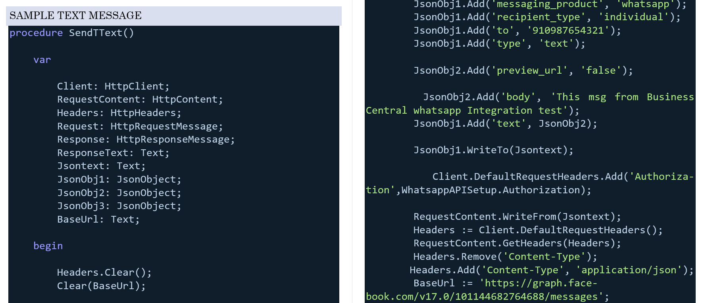
AL Code for simple text message

Slide 13
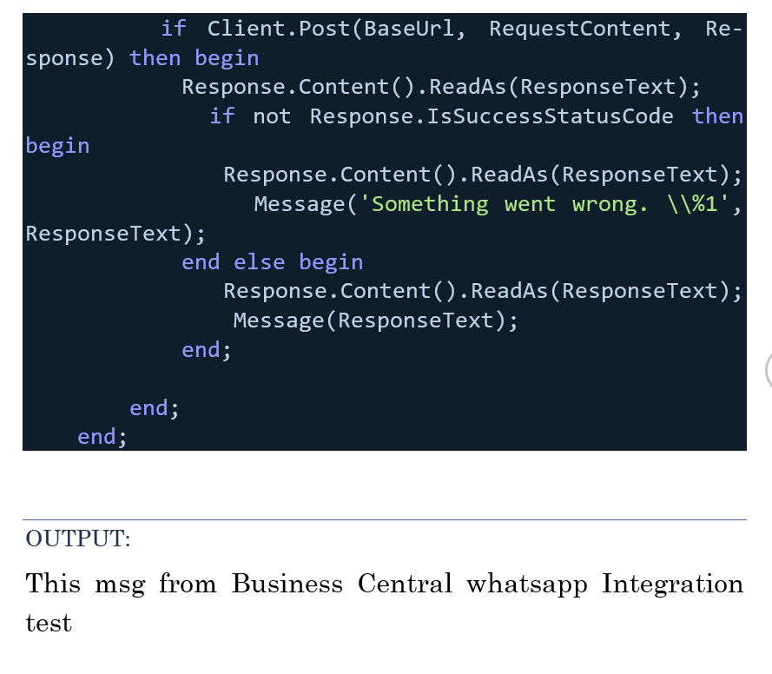

Slide 14
References
Meta Refercences
Meta Developer Documentation | Meta APIs, SDKs & Guides (facebook.com)
WhatsApp Business Platform (facebook.com)
Phone Numbers - WhatsApp Business Platform (facebook.com)
Cloud API (facebook.com)
Register - Meta App Development (facebook.com)
Create an App - Meta App Development (facebook.com)
Pricing - WhatsApp Business Platform (facebook.com)
Templates - WhatsApp Business Management API (facebook.com)
Message Template Guidelines - WhatsApp Business Platform (facebook.com)
Media - Cloud API (facebook.com)
Cloud API | WhatsApp Business Platform | Postman API Network

Slide 15
References
Other Refercences
Send Message API | WbizTool Integration Documentation
WbizTool Integration API Documentation
Top 10 Whatsapp API Providers for Business in 2023 (startuptalky.com)
Integrate WhatsApp Business with Microsoft Dynamics 365 Business Central, WhatsApp Business Microsoft Dynamics 365 Business Central integration with AI (appypie.com)
Configure a WhatsApp channel through Twilio | Microsoft Learn
WhatsApp messaging with Business Central (picazin.dev)
Integrate the WhatsApp Business API with the Microsoft Dynamics 365 Business Central API API - Pipedream

Slide 16

